Slide 1





SOCIAL BUZZ
ANALYSIS OF POPULAR CONTENT ON THE PLATFORM

Slide 2
Today’s Agenda
Project Recap
Challenge
Analytics Team
Process
Insights
Summary

Slide 3


Project Recap
Social Buzz is fastest growing technology unicorn
that needs to adapt quickly to its global scale.
Accenture has begun 3 month POC focusing on these tasks.
An audit of their big data practice
Recommendations for a successful IPO
An analysis of their content categories that highlights the top 5 categories with the largest aggregate popularity

Slide 4

Challenge
Over 500 million Users per month
vast amount of unstructured data hard to make sense of.
Need an external Expertise
More than 100,000 content per day
How to capitalize this vast amount of data?
More than 36,500,000 content per year

Slide 5



Analytics Team
01
Andrew Fleming
Chief Technology Architect
02
Marcus Rompton
Senior Principle
Stanley Victor
Data Analyst
03
Data Analyst

Slide 6
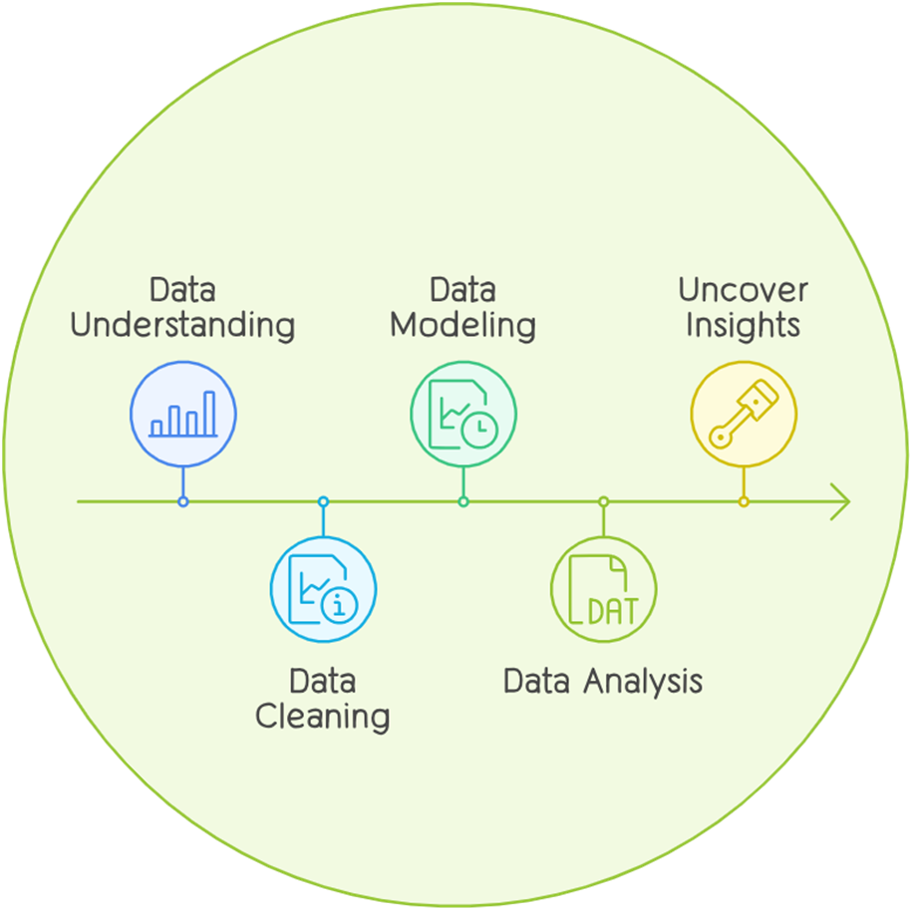
Process

Slide 7
Insights
01
16
02
1897
03
May
Unique Categories
Reactions to most popular category - Animals
Month with most posts

Slide 8
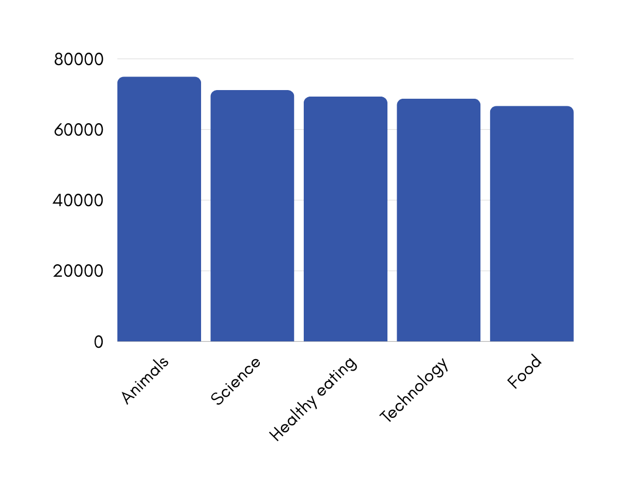

Top 5 Categories

Slide 9
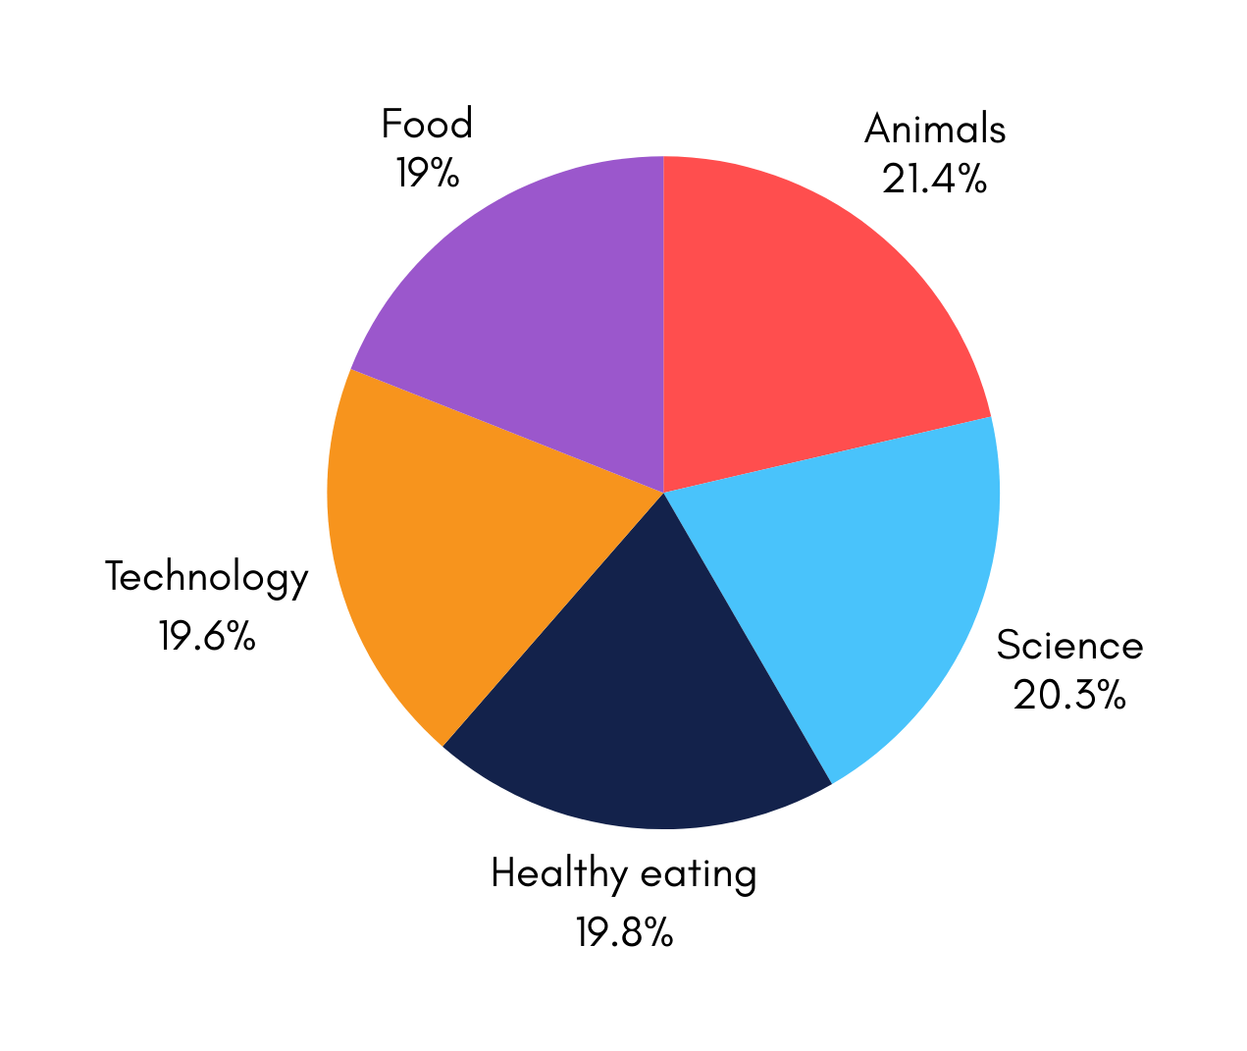

Slide 10
Summary
Analysis
Animals and Science are the two most popular categories indicating that people like “real life” and “factual’ content the most.
Insight
Food is the most common theme with “Healthy eating” and “Food” categories in the Top 5. This is an indication that the audience is within your user base. You could use this insight to work with healthy eating brand
Next Step
This ad-hoc analysis is insightful, but it's time to take the analysis into large-scale production for real-time understanding of the business. We can help you with this.

Slide 11

THANK YOU

